Slide 1
CS7357 NN/DL D2I NN Study part 1
Dr. Jiho Noh
jnoh3@kennesaw.edu
Computer Science, Kennesaw State University
Original lecture slides by Dr. Hafiz Khan

Slide 2
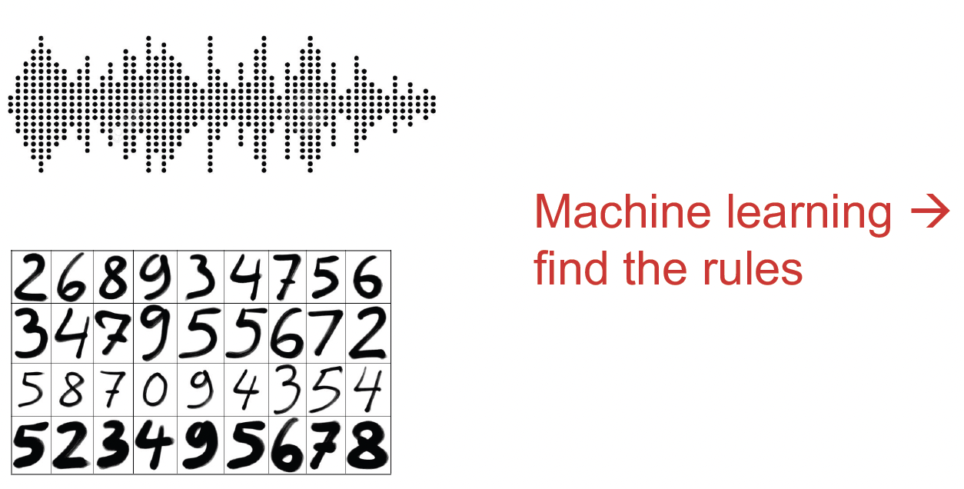
What is the Rule?

Slide 3
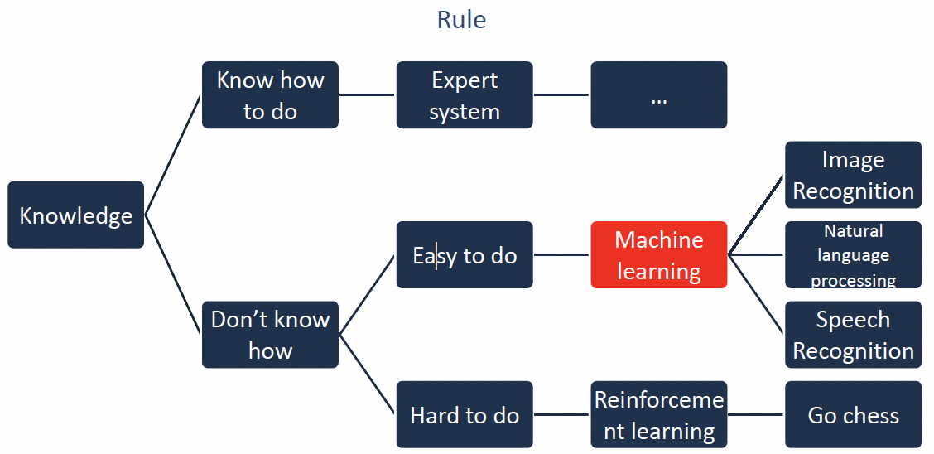
How to develop an artificial intelligence system?

Slide 4
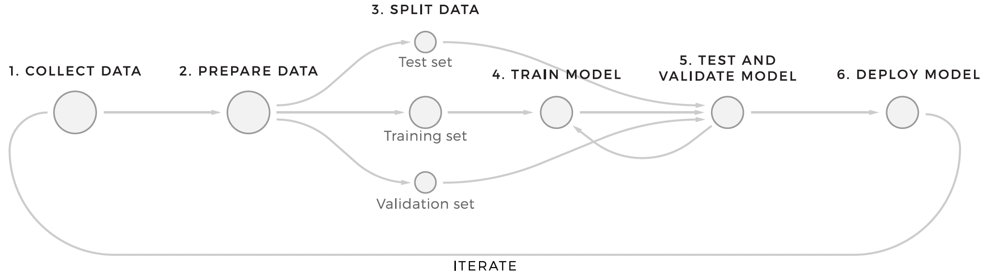
Machine learning workflows

Slide 5
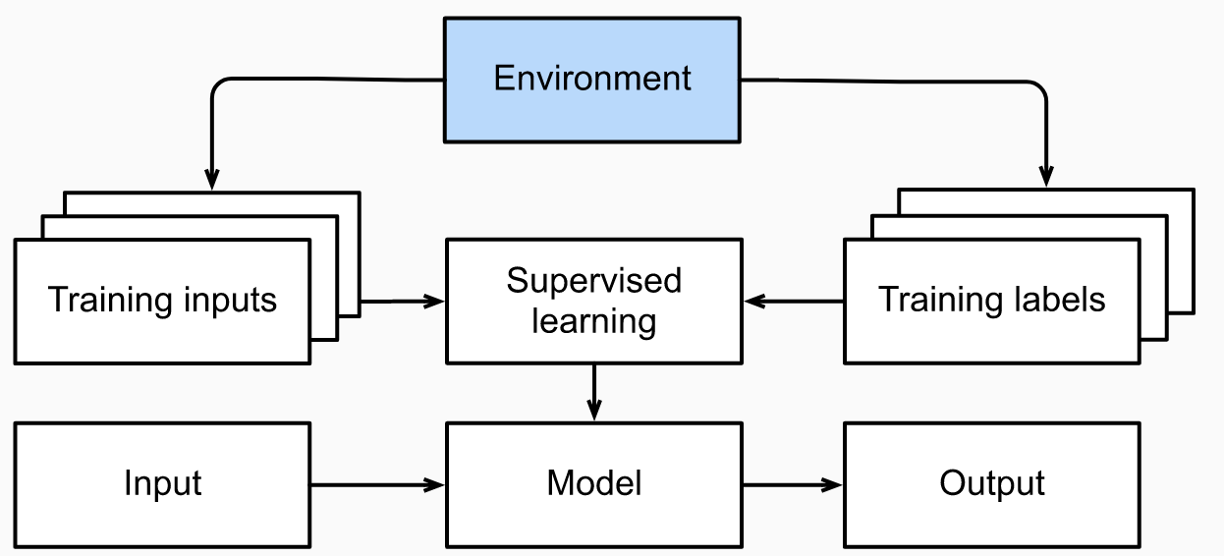
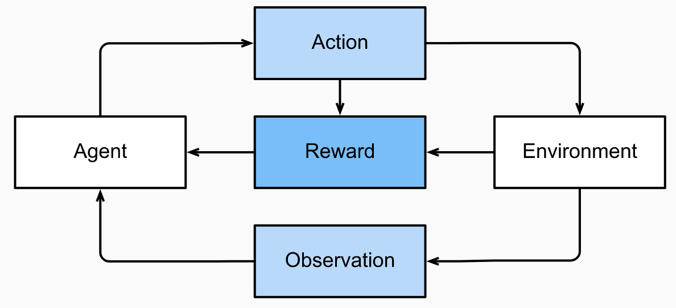
Three Model Training Styles
Supervised learning
Supervised learning algorithms operate with historic data that already has target values. Mapping these target values in training datasets is called labeling.
Unsupervised learning
The goal of machine learning, in this case, is to define patterns in values and structure the objects by similarities or differences.
Reinforcement learning
An agent (an algorithm) must make decisions based on input data and then be “awarded” or “punished,” depending on how successful these decisions were.
Supervised Learning
Reinforcement Learning

Slide 6
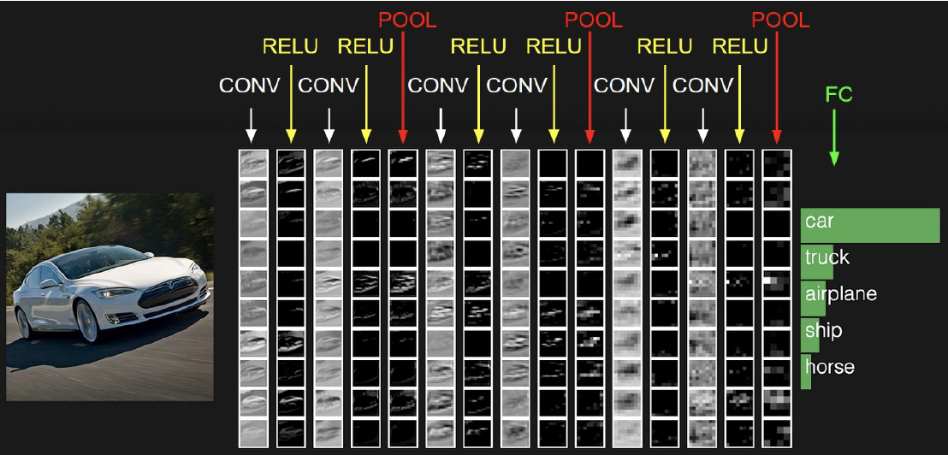
Deep learning: image recognition

Slide 7
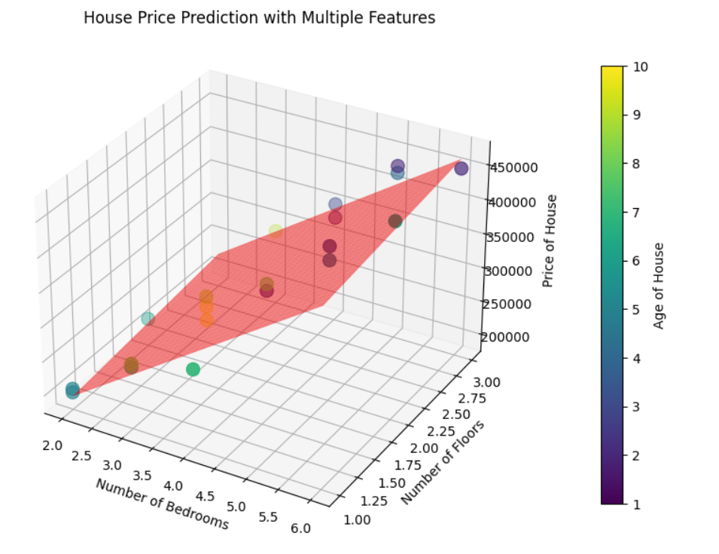
Linear Regression
The assumption of linearity means that the expected value of the target (price) can be expressed as a weighted sum of the features (bedrooms and floors):

Slide 8
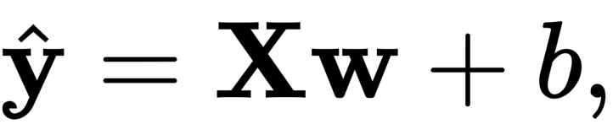
Linear Model
When our inputs consist of 𝑑 features, we can assign each an index (between 1 and 𝑑) and express our prediction 𝑦^ (in general the “hat” symbol denotes an estimate) as
In essence, a Linear model takes features of a dataset of n examples X in n x d dimensions and computes the weighted sum of features to make predictions.

Slide 9
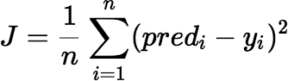
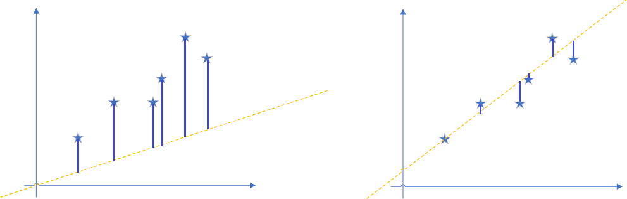
Cost Function
Figure 2 is more fitting, which means that the line in Figure 2 is closer to the ideal line

Slide 10
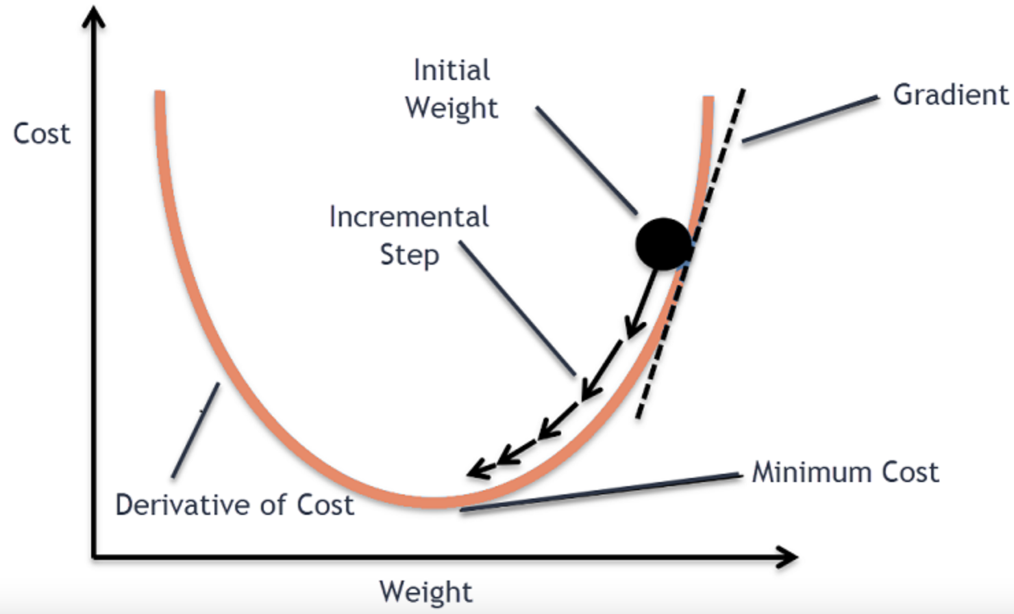
Gradient descent
Gradient descent is an iterative optimization algorithm for finding the local minimum of a function.
local minimum of a function using gradient descent
Gradient Descent: take steps proportional to the negative of the gradient (move away from the gradient) of the function at the current point – Local Minimum
Gradient Ascent: take steps proportional to the positive of the gradient (moving towards the gradient) – Local Maximum
Two Steps to minimize cost function:
1. Compute the gradient (slope)
2. Make a step (move) in the direction opposite to the gradient

Slide 11
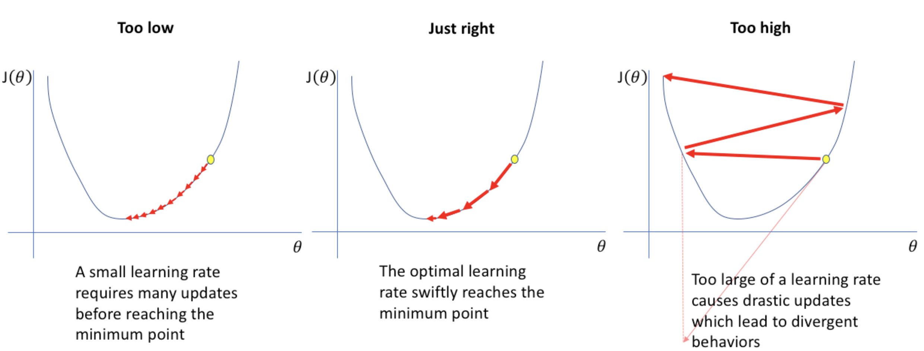
Learning Rate
https://www.jeremyjordan.me/nn-learning-rate/
Demo: https://gfycat.com/soupygiganticdwarfrabbit

Slide 12
Algorithm for SGD
Initialize the parameters of the model with random values.
Randomly select a mini-batch of data points from the dataset.
Compute the gradient of the cost function using the selected mini-batch.
Update the parameters in the direction of the gradient.
Repeat steps 2-4 until convergence or a predefined number of iterations.

Slide 13
implementation from scratch

Slide 14

Customer analysis
User
Gender
Age
Salary
…

Slide 15
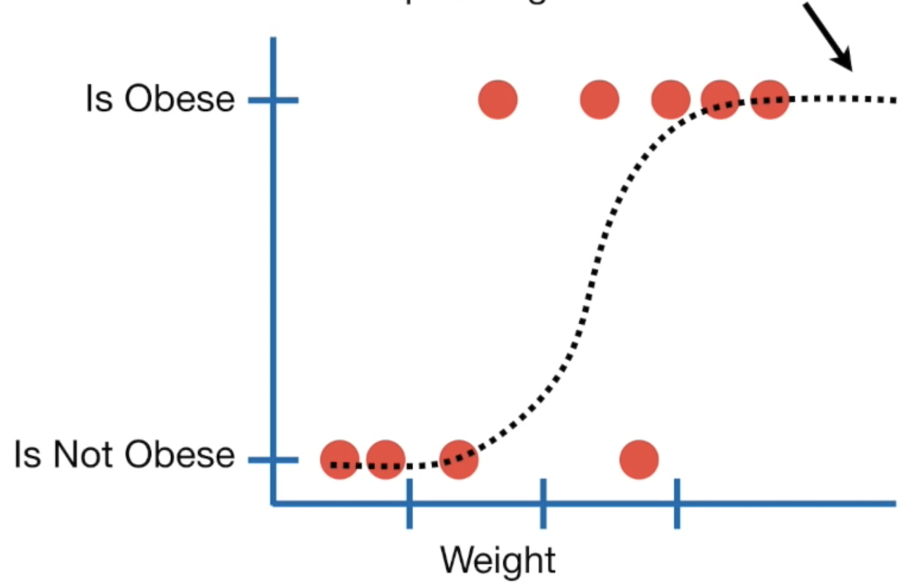
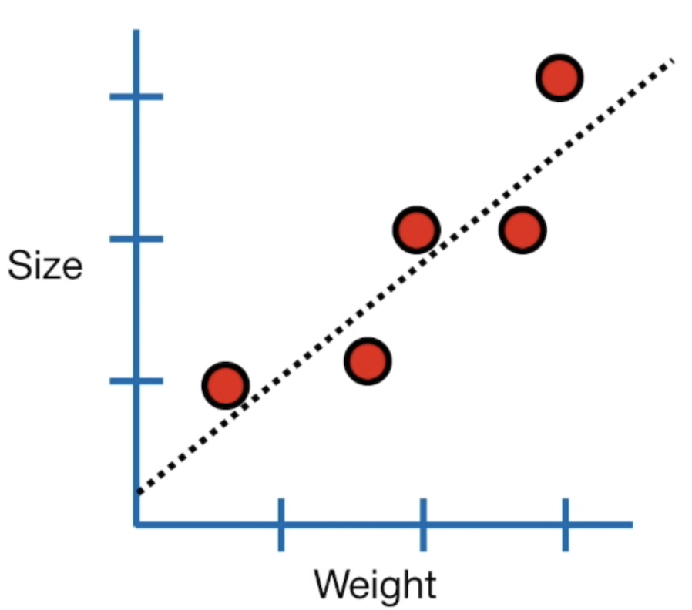
Logistic regression
Instead of fitting a line to a the data, logistic regress fits an “S” shaped “logistic function”
Logistic regression is similar to linear regression, excepts it predicts something is true or false

Slide 16
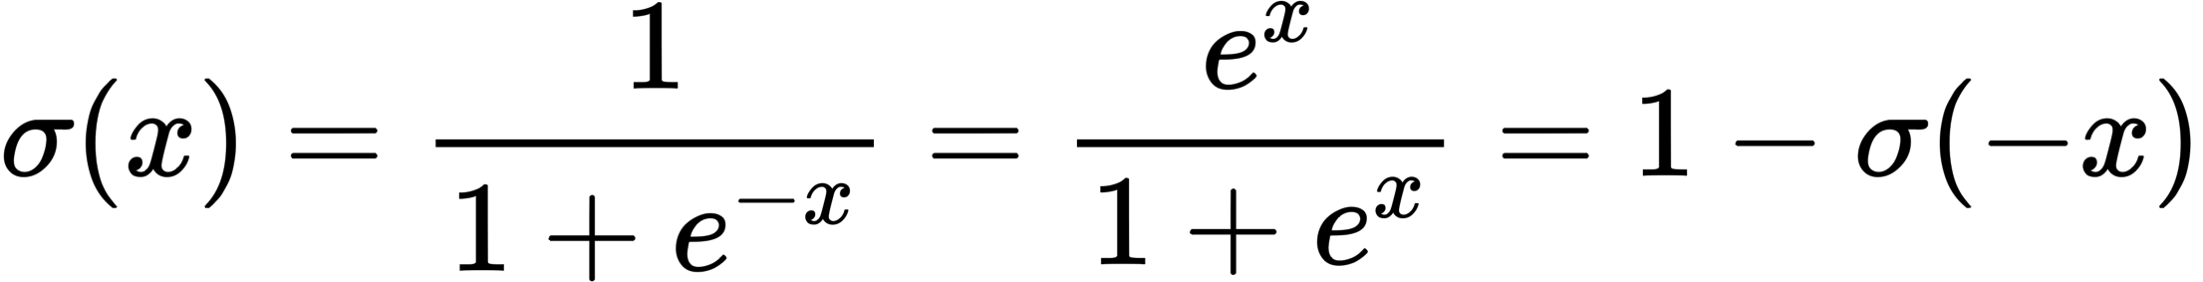

Logistic function

Slide 17
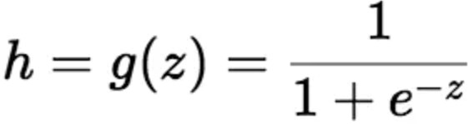
Logistic regression
Linear regression
Logistic regression

Slide 18
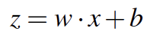
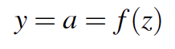
Computing Unit
x₁
w₁
x₂
w₂
$z= ∑wi.xi$+b
f(z)
y= f(z)
w₃
x₃
.
.
.
w_{n}
Represent using dot product,
x_{n}
Non-linear function, Activation,

Slide 19
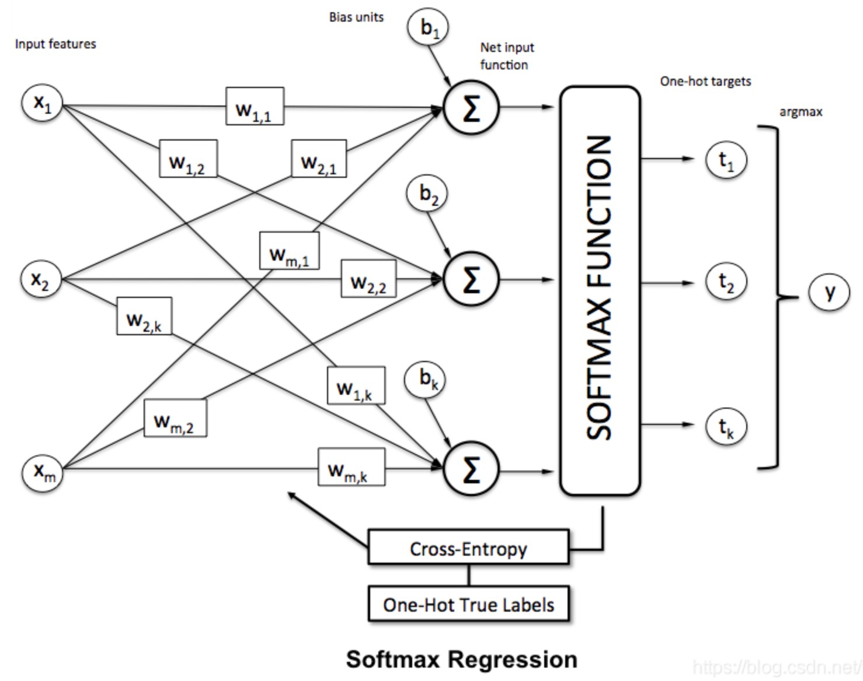
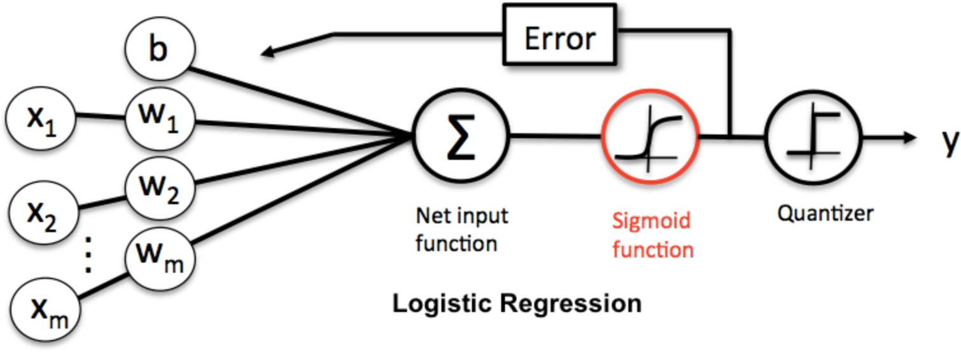
Softmax regression
Softmax regression is a general form of logistic regression. When the number of categories k = 2, softmax regression degenerates into logistic regression

Slide 20
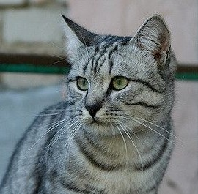
Softmax Classifier (Multinomial Logistic Regression)
Want to interpret raw classifier scores as probabilities
cat car frog
3.2
5.1
-1.7
Lecture 3 - 20

Slide 21
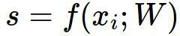
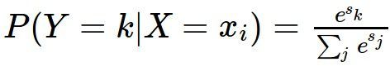
Softmax Classifier (Multinomial Logistic Regression)
Want to interpret raw classifier scores as probabilities
Softmax Function
cat car frog
3.2
5.1
-1.7
Lecture 3 - 21

Slide 22
Softmax Classifier (Multinomial Logistic Regression)
Want to interpret raw classifier scores as probabilities
Softmax Function
Probabilities must be >= 0
cat car frog
3.2
5.1
-1.7
24.5
164.0
0.18
exp
unnormalized probabilities
Lecture 3 - 22

Slide 23
Softmax Classifier (Multinomial Logistic Regression)
Want to interpret raw classifier scores as probabilities
Softmax Function
Probabilities must be >= 0
Probabilities must sum to 1
cat car frog
3.2
5.1
-1.7
24.5
164.0
0.18
0.13
0.87
0.00
exp
normalize
unnormalized probabilities
Fei-Fei Li, Ranjay Krishna, Danfei Xu
probabilities
Lecture 3 -

Slide 24
Softmax Classifier (Multinomial Logistic Regression)
Want to interpret raw classifier scores as probabilities
Softmax Function
Probabilities must be >= 0
Probabilities must sum to 1
cat car frog
3.2
5.1
-1.7
24.5
164.0
0.18
0.13
0.87
0.00
exp
normalize
Unnormalized
unnormalized
probabilities
log-probabilities / logits
probabilities
Lecture 3 -
55

Slide 25
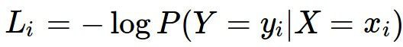
Softmax Classifier (Multinomial Logistic Regression)
Want to interpret raw classifier scores as probabilities
Softmax Function
Probabilities must be >= 0
Probabilities must sum to 1
cat car frog
3.2
5.1
-1.7
24.5
164.0
0.18
0.13
0.87
0.00
L_{i} = -log(0.13)
= 2.04
exp
normalize
Unnormalized
unnormalized
probabilities
log-probabilities / logits
probabilities

Slide 26
Softmax Classifier (Multinomial Logistic Regression)
Want to interpret raw classifier scores as probabilities
Softmax Function
Probabilities must be >= 0
Probabilities must sum to 1
cat car frog
3.2
5.1
-1.7
24.5
164.0
0.18
0.13
0.87
0.00
L_{i} = -log(0.13)
= 2.04
exp
normalize
Maximum Likelihood Estimation Choose weights to maximize the likelihood of the observed data
Unnormalized
unnormalized
probabilities
log-probabilities / logits
probabilities
Lecture 3 -

Slide 27
Softmax Classifier (Multinomial Logistic Regression)
Want to interpret raw classifier scores as probabilities
Softmax Function
Probabilities must be >= 0
Probabilities must sum to 1
cat car frog
3.2
5.1
-1.7
24.5
164.0
0.18
0.13
0.87
0.00
1.00
0.00
0.00
compare
exp
normalize
Unnormalized
log-probabilities / logits
unnormalized probabilities
probabilities
Correct probs
April 06, 2021
Lecture 3 -

Slide 28
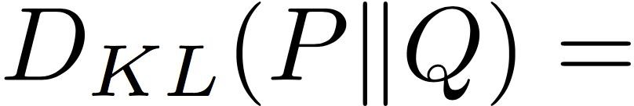
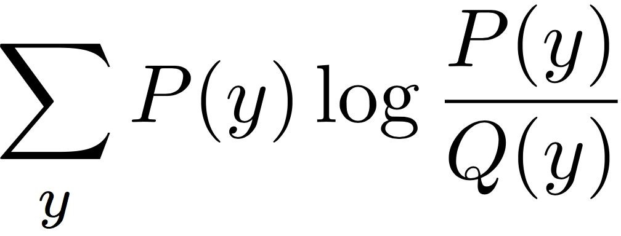
Softmax Classifier (Multinomial Logistic Regression)
Want to interpret raw classifier scores as probabilities
Softmax Function
Probabilities must be >= 0
Probabilities must sum to 1
cat car frog
3.2
5.1
-1.7
24.5
164.0
0.18
0.13
0.87
0.00
1.00
0.00
0.00
compare
exp
normalize
Kullback–Leibler divergence
Unnormalized
log-probabilities / logits
unnormalized probabilities
probabilities
Correct probs
April 06, 2021
Lecture 3 -

Slide 29
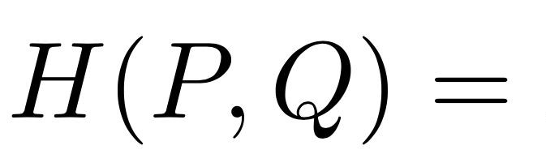
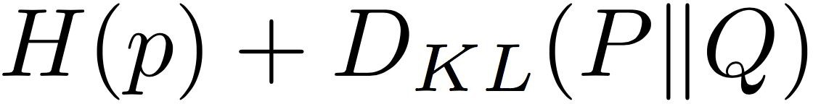
Softmax Classifier (Multinomial Logistic Regression)
Want to interpret raw classifier scores as probabilities
Softmax Function
Probabilities must be >= 0
Probabilities must sum to 1
cat car frog
3.2
5.1
-1.7
24.5
164.0
0.18
0.13
0.87
0.00
1.00
0.00
0.00
compare
exp
normalize
Cross Entropy
Unnormalized
log-probabilities / logits
unnormalized probabilities
probabilities
Correct probs
Lecture 3 -

Slide 30
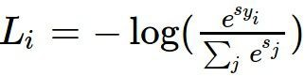
Softmax Classifier (Multinomial Logistic Regression)
Want to interpret raw classifier scores as probabilities
Softmax Function
Maximize probability of correct class
Putting it all together:
cat car frog
3.2
5.1
-1.7
Lecture 3 -

Slide 31
Softmax Classifier (Multinomial Logistic Regression)
Want to interpret raw classifier scores as probabilities
Softmax Function
Maximize probability of correct class
Putting it all together:
cat car frog
3.2
5.1
-1.7
Q1: What is the min/max possible softmax loss L_{i}?
Q2: At initialization all s_{j} will be approximately equal; what is the softmax loss L_{i}, assuming C classes?
Lecture 3 -

Slide 32
Softmax Classifier (Multinomial Logistic Regression)
Want to interpret raw classifier scores as probabilities
Softmax Function
Maximize probability of correct class
Putting it all together:
cat car frog
3.2
5.1
-1.7
Q2: At initialization all s will be approximately equal; what is the loss? A: -log(1/C) = log(C),
If C = 10, then L_{i} = log(10) ≈ 2.3
Lecture 3 -

Slide 33
implementation from scratch

